Slide 1

TRUTHSEEKER
School of Computer Science and Engineering
Department of Computer Science and Engineering
Submitted By:
Annwesa Das
23FE10CSE00044
Supervised By:
Dr Umashankar Rawat

Slide 2
Introduction
In today’s digital era, misinformation spreads rapidly across social media and online platforms, affecting public trust, awareness, and decision-making. False or misleading content can influence elections, health choices, and societal harmony, while traditional fact-checking methods often struggle to keep pace with the vast amount of online data. This rising challenge calls for automated, intelligent solutions that can analyze and verify information in real time.
Our project — TRUTHSEEKER — aims to tackle this issue through AI-driven detection and analysis. The system automatically collects online content, processes it using advanced AI models, and identifies potential misinformation with high accuracy. By delivering quick and reliable insights, it supports researchers, journalists, and the public in recognizing false narratives, thereby fostering a more informed and trustworthy digital space.

Slide 3
Literature Review
Name | Method / Technique | Real-time? | Fact-checking Source | Pros | Cons
NewsGuard (2018) | Human journalist evaluation | No | Professional journalists | Transparent methodology, nuanced analysis | Subscription model, slower updates
SurfSafe (2018) | Computer vision comparison | Yes | Image database | Specialized in image verification, real-time | Limited to images, requires database
Factual (2020) | NLP and ML analysis | Yes | Algorithm + trusted sources | Real-time analysis, confidence levels | Variable accuracy, English-focused
Fake News Detector (2017) | ML classification | Yes | Crowd-sourced data | Open-source, multi-category | Depends on training data quality
InVID (2017) | Video forensics tools | No | Manual verification | Comprehensive video tools | Complex interface, manual process

Slide 4
Literature Review
Name | Method / Technique | Real-time? | Fact-checking Source | Pros | Cons
Trusted News (2019) | Blockchain + crowd voting | Partial / Community consensus | AI models | Decentralized, manipulation-resistant | Depends on user adoption
AdVerif.ai (2020) | Deep learning | Yes | AI + professional fact-checkers | Advanced pattern detection, API-first | Limited explanation, B2B focus
Logically (2017) | Hybrid AI + human verification | Yes | AI + professional fact-checkers | Comprehensive approach, detailed explanations | Subscription for full features
B.S. Detector (2016) (Discontinued after 2018) | Database lookup | Yes | Open database | Simple, lightweight | Domain-level only, static database
MBFC (Media Bias/Fact Check) Extension (2018) | Database lookup | Yes | Media Bias/Fact Check (MBFC) database | Large database, includes bias + accuracy metrics | Source-level only, includes subjective elements

Slide 5
Problem Statement
Rapidly spreading misinformation on online platforms threatens public trust, informed discourse, and societal stability, while existing detection systems remain limited and biased
Proposed Solution
An AI-powered hybrid system combining automated detection and
human verification to identify, analyze, and flag misinformation
across multiple platforms in real time

Slide 6
Objective
Claim Detection: Automatically collect and aggregate online content from various sources for analysis
Claim Verification: Detect and flag potential misinformation using AI-driven techniques.
Enhance Coverage: Extend detection capabilities to rural and low-resource linguistic contexts through multilingual NLP models
Hybrid Verification: Combine automated AI checks with community-driven fact-checking to increase contextual accuracy and adaptability.
Human-in-the-Loop: Involve verified local fact-checkers for complex or ambiguous cases, ensuring reliability and cultural relevance.

Slide 7
Proposed Methodology
Layer | Description
Website (Frontend) | Provides real-time credibility results through an interactive interface.
Local Processing (Client-Side) | Performs preprocessing and feature extraction before sending data to the backend
Backend API (NodeJS) | Orchestrating the flow between NLP analysis, verification, and fact-checking APIs.
Fact-Checking | Includes multilingual NLP and community-driven fact-checkers for localized insights.
Result Aggregation Layer | Aggregates results from multiple sources to generate a credibility score and explanation for user understanding.

Slide 8
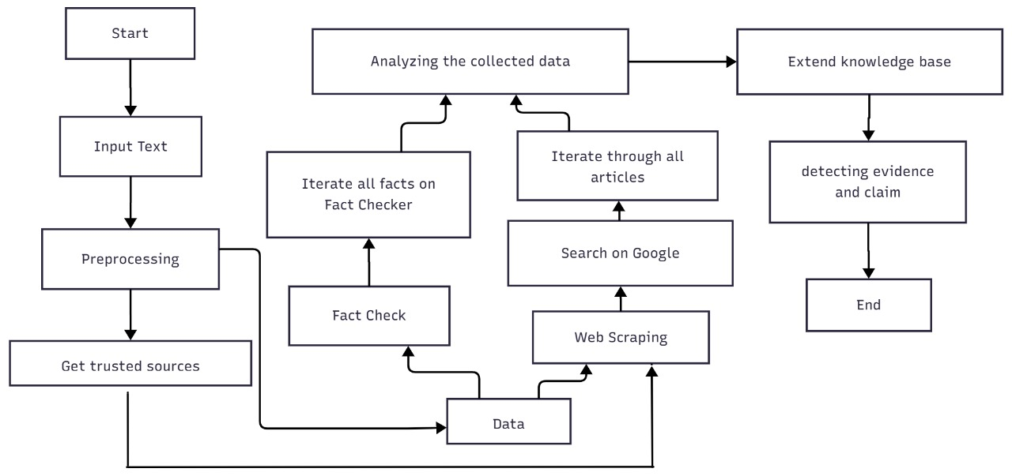
Workflow

Slide 9
Technology Stack
Component | Technologies
Frontend | HTML, CSS, JavaScript, React
Backend | NodeJS
AI/ML Models | Gemini , Google Fact checking API
Database | MongoDB
Other Tools | Web Scraping(Puppeteer), Docker, Github

Slide 10
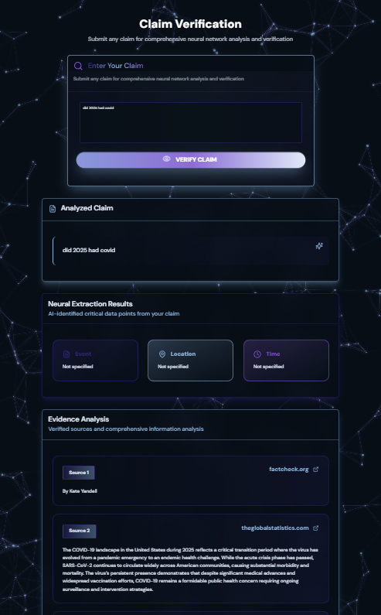
Result
Successfully scraped and aggregated data from multiple online sources.
Detected potential misinformation using AI models.
User can sign in for more personalization
Provided History log of our past queries.

Slide 11

References
Amazeen, M. A. (2020). Journalistic interventions: The structural factors affecting the global emergence of fact-checking. Journalism, 21(1), 95–111.
Augenstein, I., Lioma, C., Wang, D., Lima, L. C., Hansen, C., Hansen, C., & Simonsen, J. G. (2019). MultiFC: A real-world multi-domain dataset for evidence-based fact checking of claims. Proceedings of the 2019 Conference on Empirical Methods in Natural Language Processing, 4685–4697.
Graves, L. (2018). Understanding the promise and limits of automated fact-checking. Reuters Institute for the Study of Journalism.
Hassan, N., Arslan, F., Li, C., & Tremayne, M. (2017). Toward automated fact-checking: Detecting check-worthy factual claims by ClaimBuster. Proceedings of the 23rd ACM SIGKDD International Conference on Knowledge Discovery and Data Mining, 1803–1812.
Li, X., Meng, Y., Xiao, X., Su, F., & Li, J. (2023). Zero-shot fact verification by claim generation. Proceedings of the 61st Annual Meeting of the Association for Computational Linguistics, 1438–1450.
Liu, Z., Xiong, C., Sun, M., & Liu, Z. (2020). Fine-grained fact verification with kernel graph attention network. Proceedings of the 58th Annual Meeting of the Association for Computational Linguistics, 7342–7351.
Pan, J., Zhang, X., Chen, T., Peng, N., & Chang, K.-W. (2023). Fact-checking with LLMs is prompt-dependent: An in-depth exploration of zero-shot and few-shot methods. Proceedings of the 2023 Conference on Empirical Methods in Natural Language Processing.
Wright, D., & Augenstein, I. (2021). Claim check-worthiness detection as positive unlabelled learning. Findings of the Association for Computational Linguistics: EMNLP 2021, 476–489.
Zlatkova, D., Nakov, P., & Koychev, I. (2019). Fact-checking meets fauxtography: Verifying claims about images. Proceedings of the 2019 Conference on Empirical Methods in Natural Language Processing, 2099–2108.

Slide 12
References
Potthast, M., Kiesel, J., Reinartz, K., Bevendorff, J., & Stein, B. (2018). A stylometric inquiry into hyperpartisan and fake news. Proceedings of the 56th Annual Meeting of the Association for Computational Linguistics, 231–240.
Shu, K., Mahudeswaran, D., Wang, S., Lee, D., & Liu, H. (2020). FakeNewsNet: A data repository with news content, social context, and spatiotemporal information for studying fake news on social media. Big Data, 8(3), 171–188.
Soleimani, A., Monz, C., & Worring, M. (2020). BERT for evidence retrieval and claim verification. Proceedings of the 42nd European Conference on Information Retrieval, 359–366.
Tchechmedjiev, A., Fafalios, P., Boland, K., Gasquet, M., Zloch, M., Zapilko, B., Dietze, S., & Todorov, K. (2019). ClaimsKG: A knowledge graph of fact-checked claims. Proceedings of the 18th International Semantic Web Conference, 309–324.
Thorne, J., Vlachos, A., Christodoulopoulos, C., & Mittal, A. (2018). FEVER: A large-scale dataset for fact extraction and verification. Proceedings of the 2018 Conference of the North American Chapter of the Association for Computational Linguistics, 809–819.
Vlachos, A., & Riedel, S. (2014). Fact checking: Task definition and dataset construction. Proceedings of the ACL 2014 Workshop on Language Technologies and Computational Social Science, 18–22.
Wang, W. Y. (2017). “Liar, liar pants on fire”: A new benchmark dataset for fake news detection. Proceedings of the 55th Annual Meeting of the Association for Computational Linguistics, 422–426.

Slide 13
Thank You

